Slide 1
Programming with B4X
Lesson 4 – Variables and Range
Anywhere Software
Feb 2021

Slide 2
Today you will learn
Explain how a computer stores data in ram.
Explain what a variable is.
How to name a variable
Assign a value to a variable.
Use Mathematical Operators
Use log command to display a variable

Slide 3

Computer Memory
Notes:
Imagine that you live on a street with a few million houses all in a row; each house has as you all know its address which starts at number 1 and ends at the last house; in order to be able to locate a friend who lives on that street you need to know the number of the house. So, we have on the one hand a house number and on the other the friend who lives in that house.
The computer's central memory works in much the same way. There are many houses each with its address and a "resident" within each house. This address is called memory address and the "resident" content. On the computer often the "resident" who from now on we will call variable needs more houses to fit.

Slide 4
What happens into RAM
Main memory, often called RAM, can be visualized as a contiguous array of bytes.
An address is equivalent to an index into the memory array.
1
3
8
Notes:
When we write a program, we name the variables, and when we wonder about how the program works, we think in terms of the variable names. But when a program executes, the computer accesses and manipulates all data by their memory addresses. The compiler has the task of mapping every variable name to its unique memory address, and it is that address that is incorporated into the machine code. But where the variables are placed in memory is left up to the. So, a variable is a named location in main memory that has three characteristics: a name, a content, and a memory address. Although a variable's name is removed during compilation, the name still has a meaning in the program - either the address of the variable or its contents - and that meaning is determined by where the name appears in a given statement.

Slide 5
What happens into RAM
Example: We need to store 1 Integer into memory
1
We declare variables by writing a name and its type:
Private A As Int
3
A: Is the Name that we decided
Int: Is the Type of Value
Compiler understands that we need a place in the Ram to store Integer Value
8

Slide 6
What happens into RAM
Private A As Int
12
43
12
43
23
43
1
Compiler finds a free memory address and changes in our program the “A” with this address.
3
Now the A name becomes #3 which is the address of the integer
8

Slide 7
How many variables do you need?
Keywords
Reads
Ask
Accept
Type
Represents
DATA
Keywords
Calculates
Displays
Writes
Counts
Convert
Represents
INFORMATIONS
Notes:
Usually in a programming problem we find variables in the description with the help of keywords such as: Reads, Registers, Ask, Accept, Type
Information’s in programming are all the elements that we need to calculate after processing our data. We usually find them in pronunciation using keywords such as:
Calculates, Displays, Writes, Counts, Convert

Slide 8
Variable Types
Notes:
With bold you can see the types we need in our lessons

Slide 9
Naming Variables
They must start with a capital or small character.
They can have digits or the character underscore.
B4X does not distinguish capital and small letters.
Cool Variables
Private intAge as Int
Private fltAmount as Float
Private strName as String
Notes:
It’s a good practice to name variables beginning with 3 small letters indicating the kind of a variable and continue with 1 uppercase letter and a meaningful word.

Slide 10
The following Variable Names are correct?
Name | True | False
int Age | □ | □
_fltAmount | □ | □
strName | □ | □
1myAge | □ | □
int_value | □ | □
✓
✓
✓
✓
✓

Slide 11
Find the Variables
It's the end of the semester and you got your grades from three classes: Geometry, Algebra, and Physics. Create a program that gives in 3 variables the grades of these 3 classes (Grades range from 0 - 10) and calculate the average of your grades.
Data | Information
Geometry
Algebra
Physics
intGeom
intAlg
intPhys
fltAvg
average
Now give them a suitable Name

Slide 12
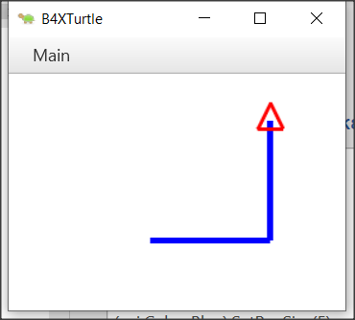
Declaring Variables in B4X
‘Program: My First Variable
Sub Turtle_Start
Private intDistance As Int
Public intTurn As Int
intDistance = 100
intTurn = 90
Turtle.SetPenColor(xui.Color_Blue).SetPenSize(5)
Turtle.MoveForward(intDistance)
Turtle.TurnLeft(intTurn)
Turtle.MoveForward(intDistance)
End Sub
Notes:
In B4X to use a variable we must first inform the language of its existence in order to commit space in the computer's memory to store its value.
The declaration of variables begins with the keyword Private or Public.
Private means that the variable is known only in the specific space declared and no other program or subprogram does not know its existence and thus the value it contains.
Instead, a variable statement that starts with the keyword Public can be known to other programs or subprograms or classes etc.

Slide 13
Scope
Private intDistance As Int
Public intTurn As Int
Notes:
The declaration of variables begins with the keyword Private or Public.
Private means that the variable is known only in the specific space declared and no other program or subprogram does not know its existence and thus the value it contains.

Slide 14
Comments
‘Program: My First Variable
‘This program draws a right angle, with sides as much as the ‘value of the intDistance variable
Sub Turtle_Start
Private intDistance As Int
Public intTurn As Int
intDistance = 100 ‘The sides of the right angle
intTurn = 90 ‘90o angle
Turtle.SetPenColor(xui.Color_Blue).SetPenSize(5)
Turtle.MoveForward(intDistance)
Turtle.TurnLeft(intTurn)
Turtle.MoveForward(intDistance)
End Sub
Notes:
In computer programming, a comment is a programmer-readable explanation or annotation in the source code of a computer program. They are added with the purpose of making the source code easier for humans to understand and are generally ignored by compilers and interpreters. The syntax of comments in various programming languages varies considerably.
In B4X comments are inserted by writing the character ' as their first letter. From this point on it is not recognized by the translator of the language. Generally, in B4X comments you should put anywhere it is important to remember what you are doing as well as before the subprograms to explain what their job is. Comments are easily distinguished in code from the green color given to them by the programming environment (IDE).

Slide 15
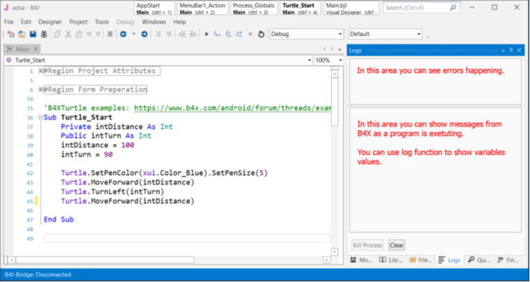
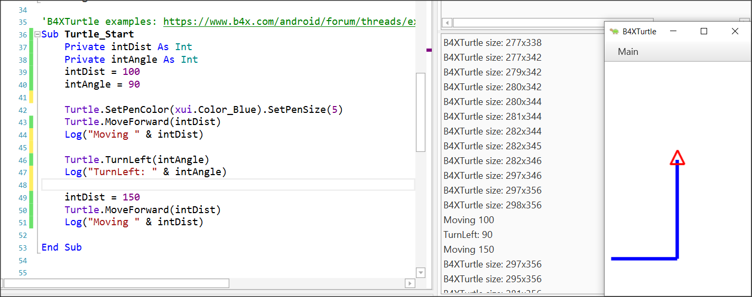
The log area and the log function.
Notes:
During programming various errors occur. Generally, errors in programming are divided into two categories syntax and logical. For now, we will deal with the syntax errors that are recognized by the programming language and indicate them on the logs screen. In order to access the logs screen, we need to click on the relevant logs tab at the bottom right. The Logs screen itself is divided into two frames, the first of which displays errors and the bottom screen displays language messages or that information we want to display using the log() function. Using the Log() function helps the developer display messages while running a program as well as variable values to help control the program's proper operation.

Slide 16
Mathematical Operators
Operator | Example | Operation
+ | x + y | Addition
- | x - y | Subtraction
* | x * y | Multiplication
/ | x / y | Division
Mod | x Mod y | Modulo
Power | Power(x,y) x^{y} | Power of

Slide 17
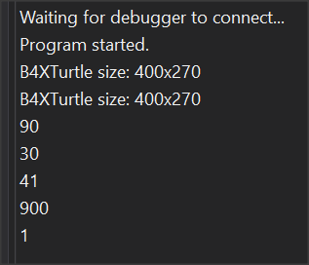
Examples
Private intA, intB, intC, intS As Int
Private fltD, fltM As Float
intA = 40
intB = 20
intC = 30
intS = intA + intB + intC
Log(intS) ‘Shows 90
fltD = intS / 3
Log(fltD) ‘Shows 30
intA = intAa + 1 ‘Increase int A by 1
Log(intA) ‘Shows 41
intS = Power(intA – 11, 2) ‘30²
Log(intS) ‘Shows 900
fltM = intA mod 2 ‘41 modulo 2
Log(fltM) ‘Shows 1
Log Screen

Slide 18
Strings
In computer programming, a string is traditionally a sequence of characters, either as a literal constant or as variable. The latter may allow its elements to be mutated and the length changed, or it may be fixed.

Slide 19
Working with Strings
Declaring 2 Strings
Private strName, strSurName as String
strName = “George”
strSurName = “Smith”
Private strPerson as String
strPerson = strName & “ “ & strSurName
log(strPerson) ‘ shows George Smith in log screen
Private strName2 as String
strName2 = “John”
strName2 = strName2 & “ Smith”
Asing Values to Strings
Join Strings into New
Notes:
A string is declared like the other variables using the String statement
Assigning value to a string can be done with the = symbol or by reading a value from the user (something we'll see later).
Also we can join string together using the character &.

Slide 20
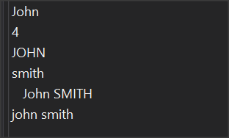
String Functions
Private strName, strSurName As String
Private strPerson As String
strName = "John"
strSurName = "SMITH"
Log(strName)
Log(strName.Length)
Log(strName.ToUpperCase)
Log(strSurName.ToLowerCase)
strPerson = " " & strName & " " & strSurName
Log(strPerson)
Log(strPerson.Trim.ToLowerCase)
Log Screen

Slide 21
Thank you!!!
Photos taken From:
https://unsplash.com/photos/iGLLtLINSkw
https://unsplash.com/photos/uq2E2V4LhCY
https://unsplash.com/photos/gySMaocSdqs

